Slide 1


Databases and SQL
Foundations for Data Management

Slide 2





Meet your Trainer
NAME
MAIMOONA KHILJI
EDUCATION
MS DATA SCIENCE (2025-27)
BS DATA SCIENCE (2019-23)
from the Institute of Management Sciences
EXPERIENCE
DATA SCIENTIST
| Atomcamp
Visiting Faculty
| Institute of Management Sciences
ACHIEVEMENTS
DISTINCTION HOLDER + MICROSOFT-CERTIFIED
Straight A+ student, speaker and panellist in various tech forums, recipient of multiple merit-based scholarships.

Slide 3

WHAT IS A DATABASE?
A database is an organized collection of structured information, or data, typically stored electronically in a computer system. It can contain any type of data, including words, numbers, images, videos, and files.

Slide 4
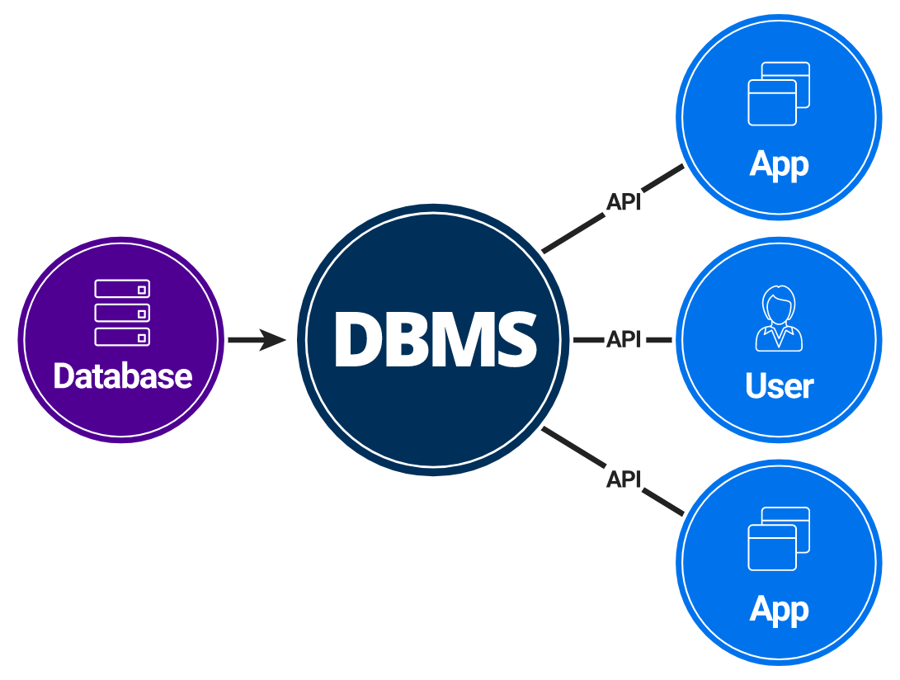
DATABASE MANAGEMENT SYSTEMS (DBMS)
Software to manage and interact with databases.
Data creation, storage, retrieval, and manipulation.
User access control and security.
Backup and recovery.
Examples: MySQL, PostgreSQL, MongoDB, Oracle DB.

Slide 5
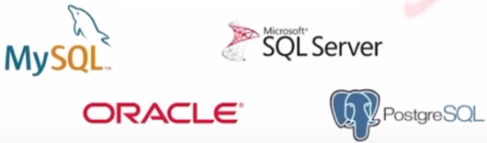

Types of Databases
Relational
Data stored in tables
(rows and columns)
Non-Relational
Data not stored in tables (unstructured)

Slide 6
Real-World Applications
Customer data analysis
Financial reporting
Inventory management
User activity tracking
Business intelligence dashboards

Slide 7
Structured Query Language (SQL)
A computer language for:
Storing data
Manipulating data
Retrieving data
SQL is the standard language for Relational Database Systems.
Why SQL?
It is easy to understand.
Queries are short.
It allows users to describe, define, manipulate and drop the data.

Slide 8
SQL Components
Data Definition Language (DDL):
Used to define and modify the structure of a database. (CREATE, ALTER, DROP.)
Data Manipulation Language (DML):
Used to access, manipulate, and modify data within the database.(INSERT, UPDATE, DELETE.)
Data Query Language (DQL):
Used to query and extract essential information from the database.(SELECT.)
Data Control Language (DCL):
Managing access and permissions.(GRANT, REVOKE.)
Transaction Control Language (TCL):
Manage transactions within databases.(COMMIT, ROLLBACK.)

Slide 9
MySQL
MySQL:
Open-source relational database management system.
Key Features:
Open Source
Community and enterprise editions are available.
High Performance
Optimized for speed and efficiency.
Ease of Use
User-friendly interface for developers.

Slide 10
Databases vs Excel
Data Size:
Excel for small, databases for large datasets.
Complexity:
Excel for simple tasks, and databases for complex structures.
Security:
Excel for basic needs, databases for robust security.
Collaboration:
Excel for individual work, databases for team collaboration.

Slide 11
WHY DO DATABASES MATTER?
Data Organization:
Structured storage facilitates efficient data management.
Data Retrieval:
Quick and precise retrieval of information.
Data Integrity:
Ensures accuracy and consistency of stored data.
Scalability:
Adaptable to growing data needs.

Slide 12
Conclusion
Databases and SQL are foundational elements in managing and interacting with data. Understanding these concepts is crucial for effective data management in various applications.

